Slide 1


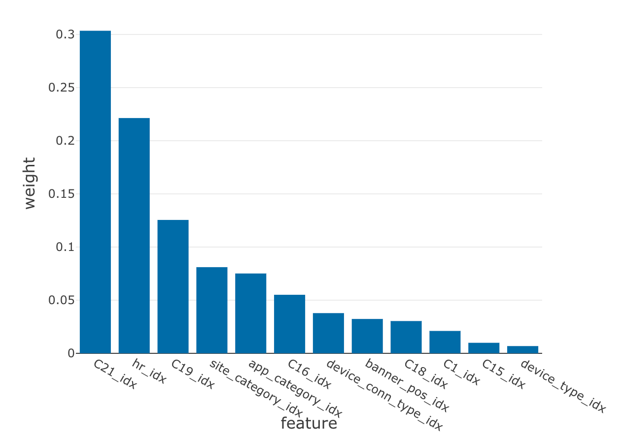
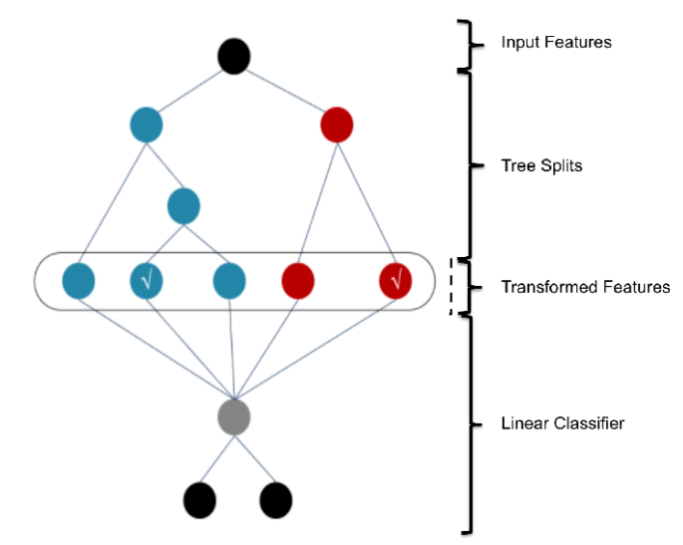
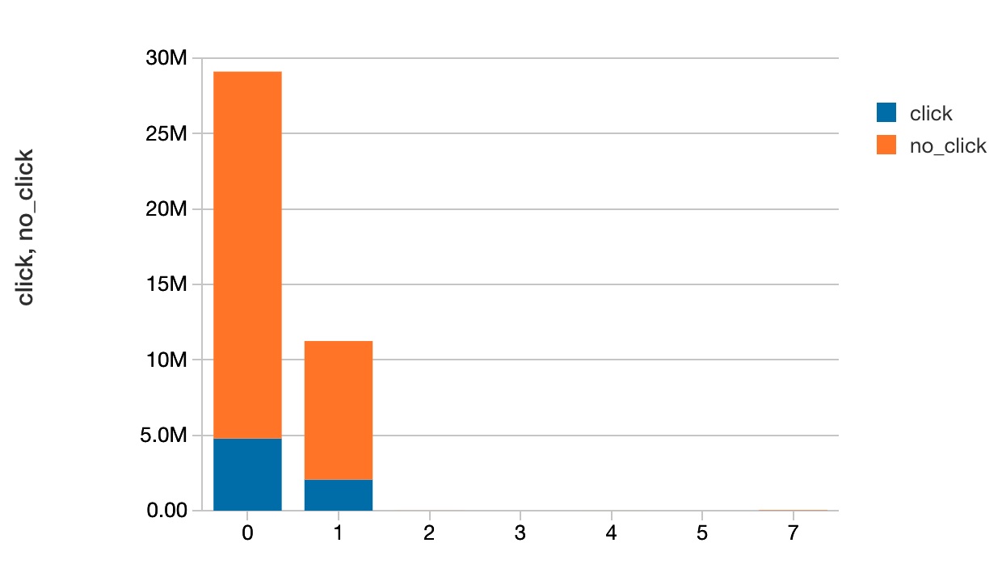
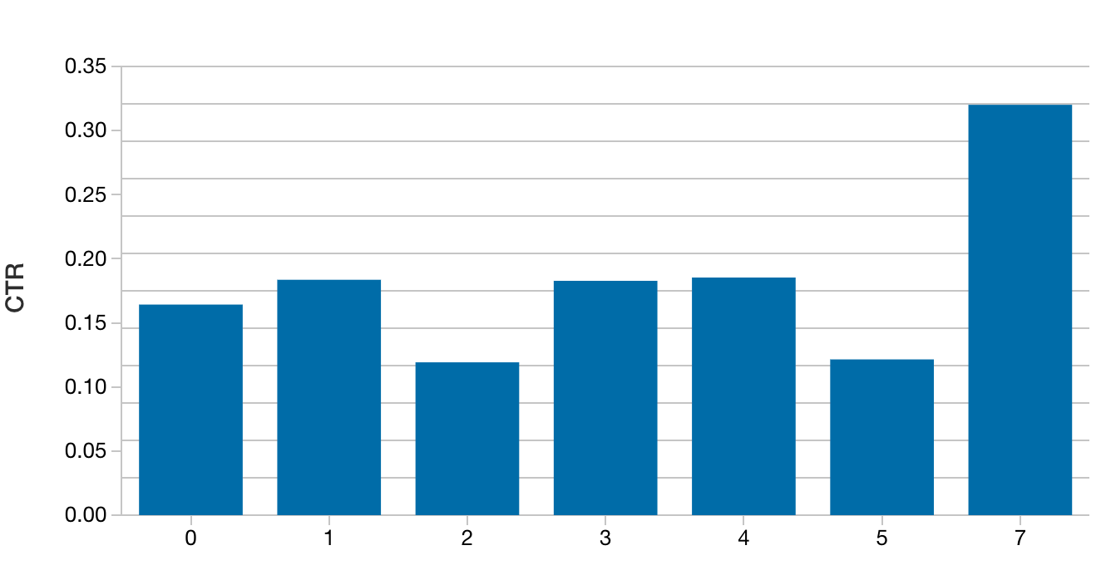
Ads Click Through Rate Prediction
SI 671: Data Mining
Students: Zi Gu, Yiqi Ye
Advisor: Prof. Paramveer Dhillon
Introduction
Road Map
Feature Importance
CTR stands for Click-through rate, which measures the ratio of clicks (how often someone clicked on your ad) to impressions (how many times your ad was viewed on the platform) for individual ads. CTR is an important metric because it helps companies understand their customers and inform them what works when trying to reach the target audience.
Data Preprocessing
Save data as parquet file for pyspark
Removed variables with over 70 unique values for the sake of model simplicity
One-Hot Encoding categorical variables
Algorithms
Logistic Regression with regularization (baseline)
Tree-based Model(GBDT & RF)
GBDT + LR(shown on the left)
Objective
We aim to build a ML model to predict CTR using historical data while find out the most influential features
Result and Conclusion
GBDT + LR predicts faster than GBDT and more accurate than LR
AUC Score of GBDT + LR doesn’t improve much from GBDT possibily due to LR simplicity
GBDT + LR runs slower than LR due to high dimensional sparse features.
In the future, we could introduce FM in replacement of LR for faster convergence and deep learning models for better predictive performance.
EDA
Model Performance
Higher frequency != higher CTR
Ads’s position (Shown below as an example)
Device Type
Site Category
Hours of a day
Experiment | Validation AUC | Test AUC
Logistic Regression | 0.67 | 0.6
Random Forest Classifier | 0.75 | 0.70
Gradient Boosting Tree Classifier | 0.77 | 0.70
GBDT+LR (L1 Regularization) | 0.74 | 0.71

